Slide 1
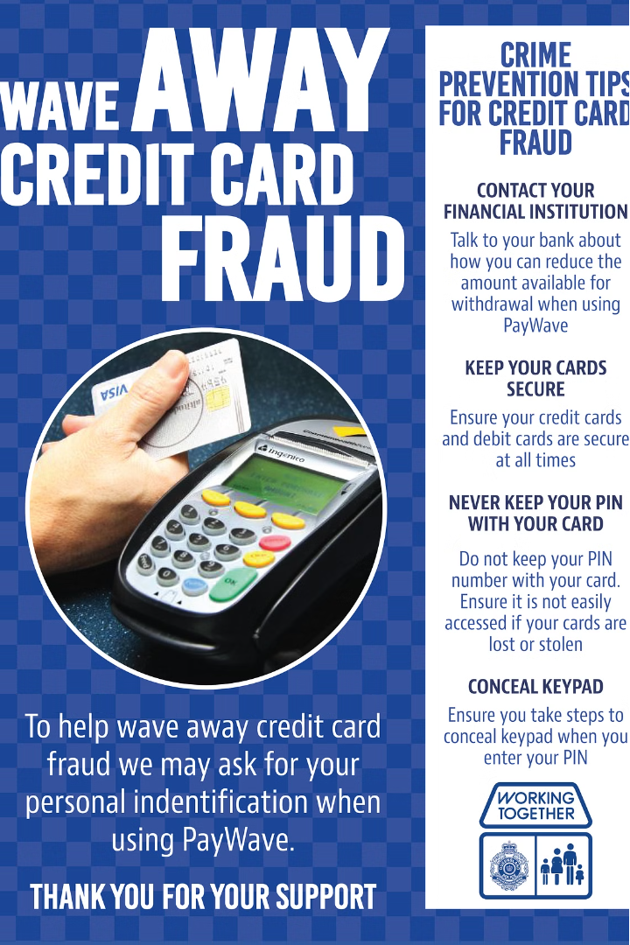


Credit Card Fraud Detection
BY
112103025 - PARAS BHOSALE 112103054 - SPANDAN JATHAR 112103063 - ABHISHEK KAKADE

Slide 2
Introduction
With the development and popularity of credit cards, more and more people hold credit cards in current society. According to a credit card processing company, there are 2.8 billion credit cards worldwide. However, this widespread usage also attracts fraudulent activities, leading to financial losses for both cardholders and financial institutions. Therefore, the development of effective credit card fraud detection systems is crucial to safeguarding the integrity of financial transactions. This project aims to explore techniques for detecting and preventing credit card fraud, ultimately contributing to enhanced security in financial transactions.

Slide 3
Logistic Regression for Fraud Detection
What is Logistic Regression?
How it Works
Key Advantages
Logistic regression analyzes the relationship between transaction features and the probability of fraud, allowing the model to identify high-risk patterns.
Interpretable results, scalable to large datasets, and can be easily deployed for real-time fraud detection.
A statistical model used to predict a binary outcome, such as whether a transaction is fraudulent or legitimate.

Slide 4
Data Preprocessing for Fraud Detection
Data Collection
1
Gather historical transaction data, including information about the cardholder, merchant, and transaction details.
2
Data Cleaning
Handle missing values, remove duplicates, and address any inconsistencies in the dataset.
Feature Engineering
3
Create new variables that capture useful insights, such as transaction velocity, location anomalies, and spending patterns.

Slide 5
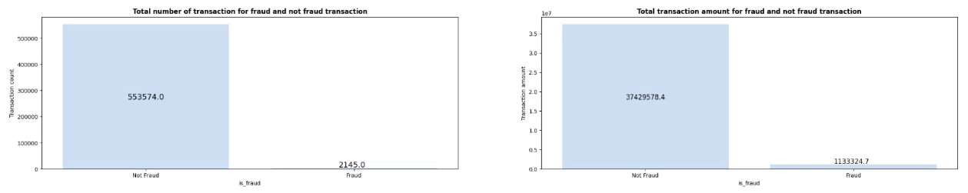
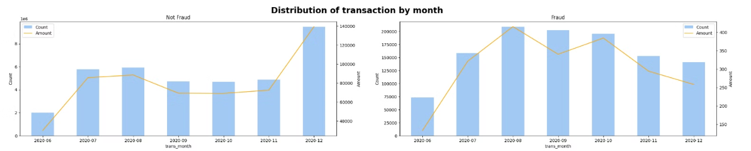

Slide 6
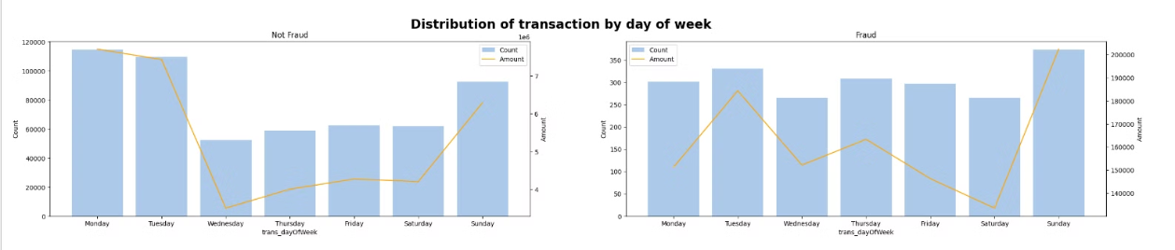
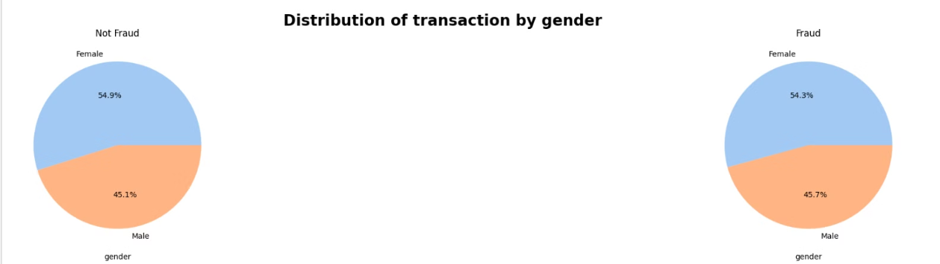

Slide 7
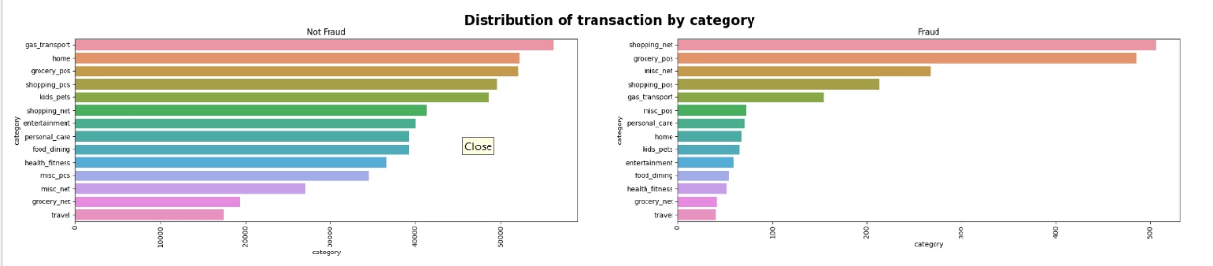
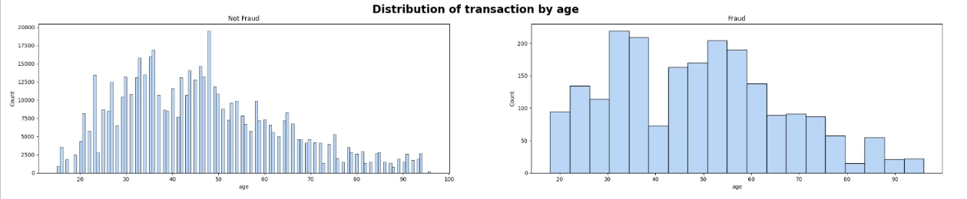

Slide 8
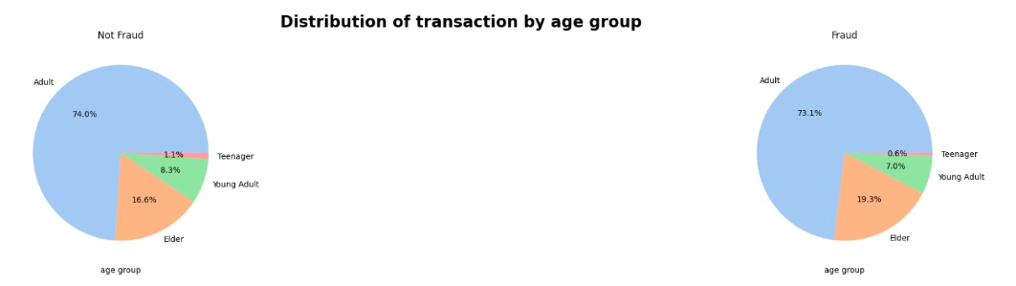
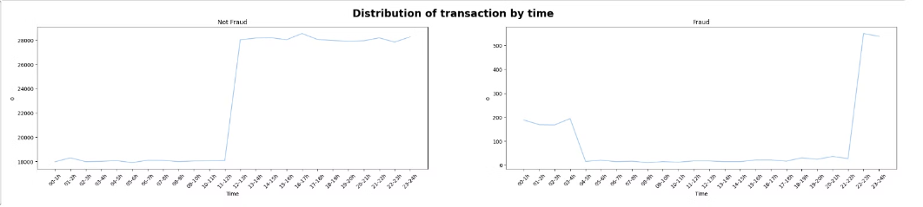
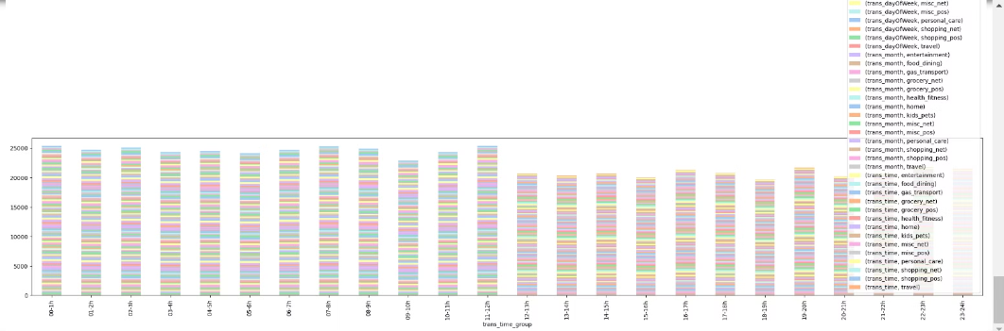

Slide 9
Feature Selection for Fraud Detection
1
Transaction Amount
2
Merchant Category
Unusually high or low transaction amounts can be indicative of fraud.
Certain merchant categories are associated with higher fraud risk, such as online retailers or gambling establishments.
3
Location Anomalies
4
Spending Patterns
Sudden changes in the cardholder's location or transactions from unfamiliar regions can signal potential fraud.
Deviations from the cardholder's typical spending habits can be a red flag for fraudulent activity.

Slide 10
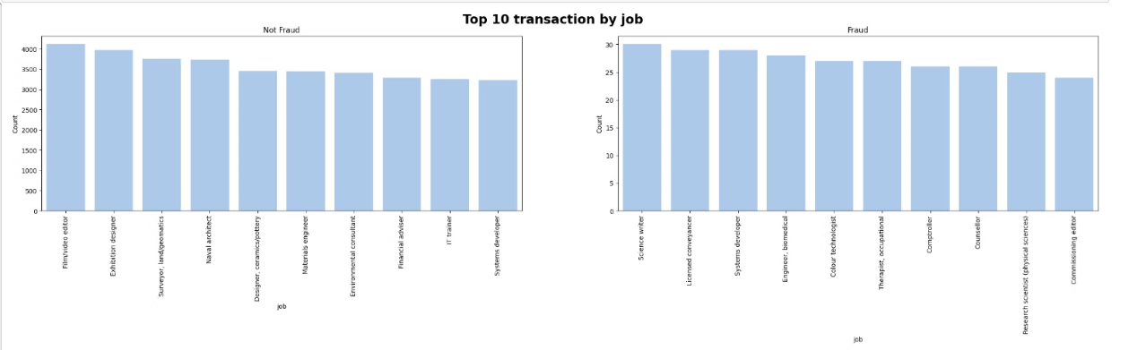
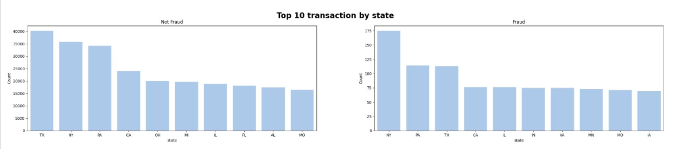

Slide 11
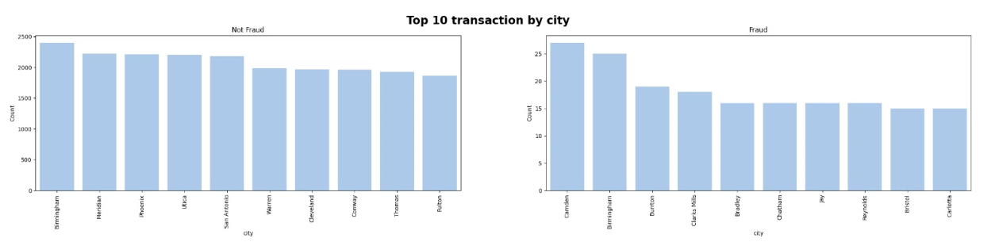
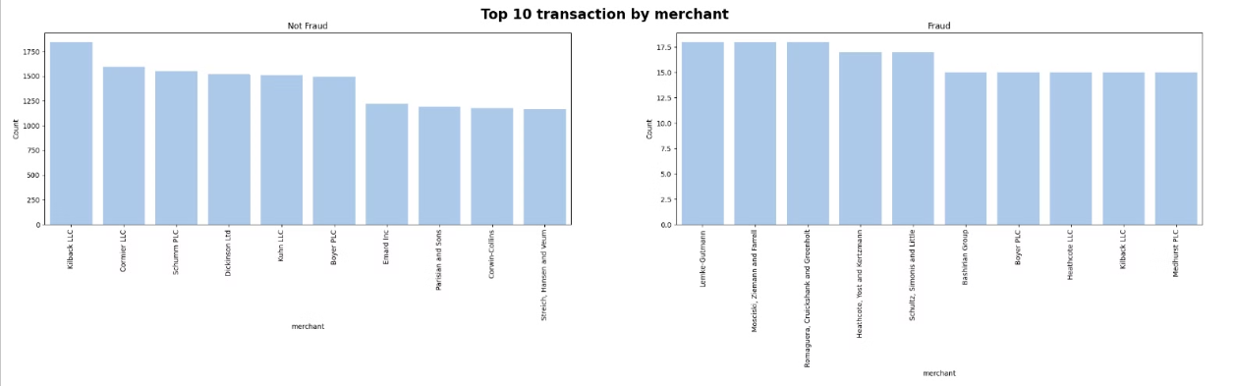

Slide 12
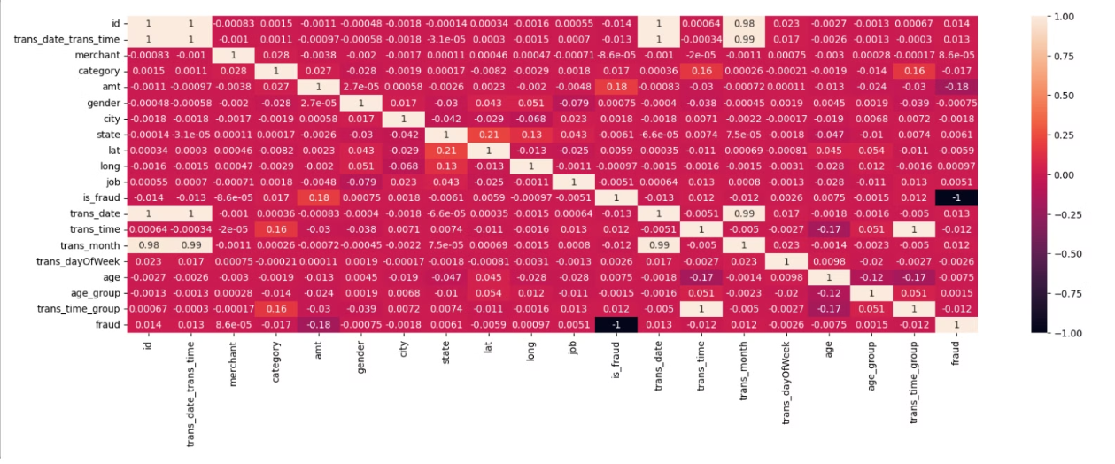
Correlation Heatmap

Slide 13



Training the Logistic Regression Model
Data Splitting
Model Fitting
Hyperparameter Tuning
Divide the dataset into training and testing subsets to evaluate the model's performance.
Fit the logistic regression model to the training data, allowing it to learn the relationships between features and fraud.
Optimize model parameters, such as the regularization strength, to improve the model's predictive accuracy.

Slide 14
Evaluating the Logistic Regression Model
Metric
Description
Accuracy
Overall percentage of correct predictions
Precision
Percentage of true fraudulent transactions among all predicted fraudulent transactions
Recall
Percentage of true fraudulent transactions correctly identified by the model
F1-Score
Harmonic mean of precision and recall, a balanced measure of model performance

Slide 15
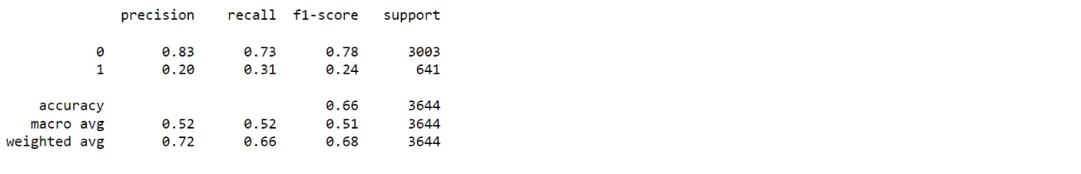
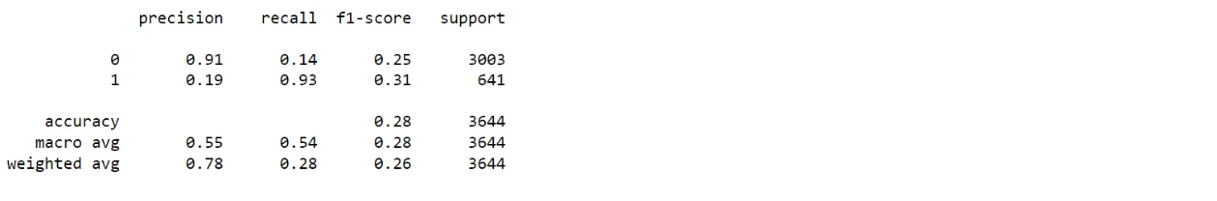
Logistic Regression
Decision Tree Classifier

Slide 16



Deploying the Fraud Detection System
Real-Time Detection
Fraud Alerts
Monitoring Dashboard
The logistic regression model can be integrated into a live transaction processing system to identify fraud in real-time.
Flagged transactions can trigger immediate alerts, allowing prompt action to be taken and losses to be minimized.
A comprehensive dashboard can provide insights into the model's performance and track fraud trends over time.

Slide 17

Conclusion and Future Considerations
Continuous Improvement
Exploring Other Models
Regularly update the logistic regression model as new data becomes available to maintain its effectiveness.
Consider experimenting with other machine learning techniques, such as neural networks or random forests, to further enhance fraud detection accuracy.
Collaboration and Innovation
Engage with industry experts and researchers to stay informed on the latest advancements in credit card fraud detection technology.

Slide 18
THANK YOU

